Slide 1
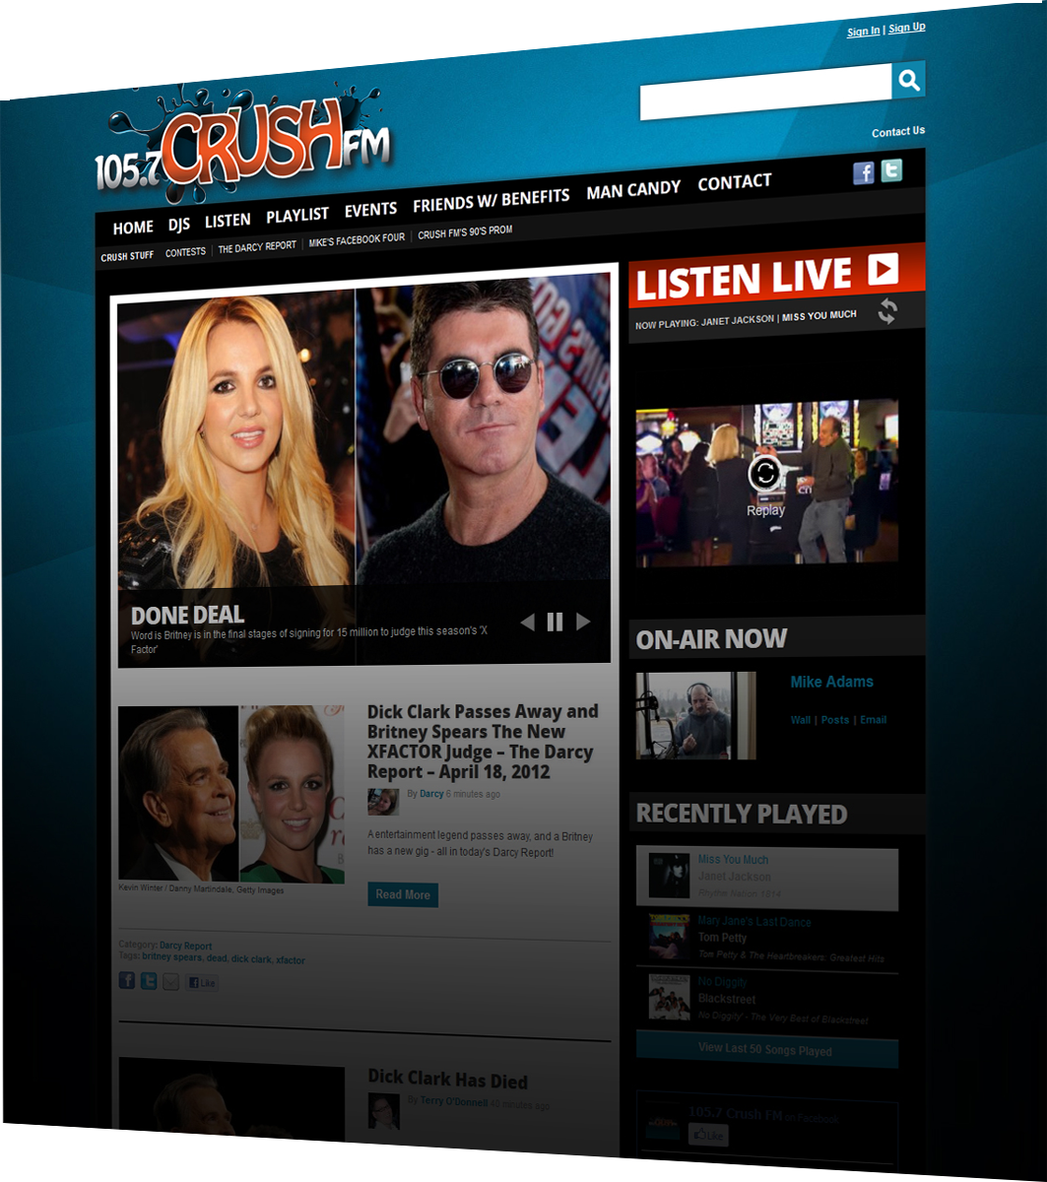
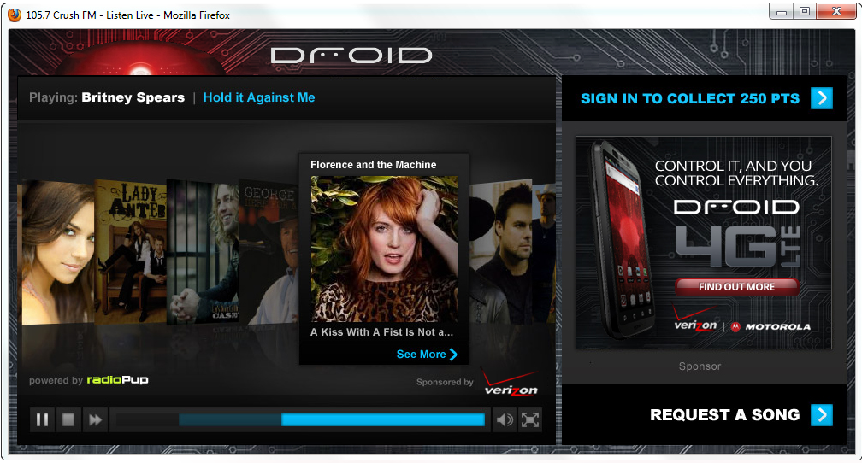
[STATION] Listen Live Player Sponsorship
Align your brand with one of the most popular features on our website
Deliver your message to our most active listeners.
Listen to the station anytime, on any computer
Dominate the entire player with your brand
Exclusive Title Sponsor of the Listen Live Player receives:
Pre Roll Video (25% of plays)
50 :30 Streaming Spots/month w/ companion banner
Clickable and persistent Presented By Logo on player
(100% EXCLUSIVE)
Custom player skin
(100% EXCLUSIVE)
plus 300x250 default ad
(except during commercials)
Price: $XX / month
0 Proprietary & Confidential

